Slide 1
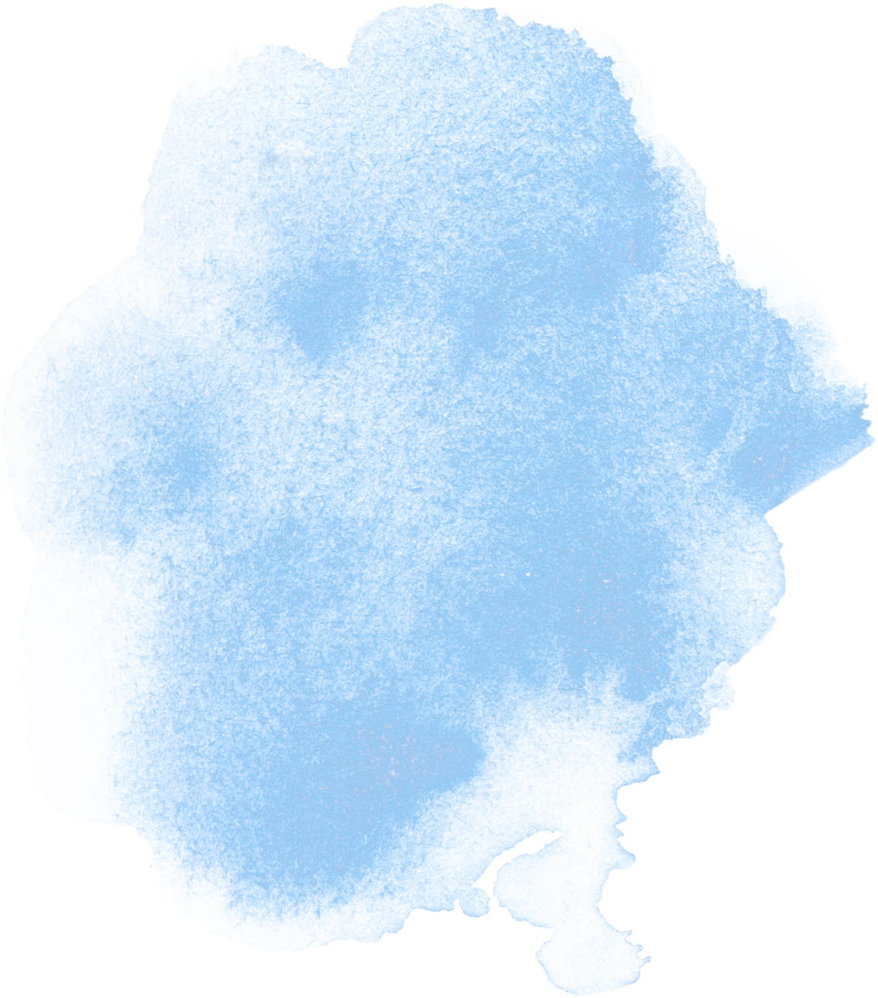
Chapter 1 Digital Number Systems
and Logic Circuits

Slide 2
Lesson objectives
Understand number system conversions
Convert Hexadecimal to Binary using grouping method
Convert Decimal to Binary, Octal, Hexadecimal using division methods

Slide 3
Conversion of Hexadecimal to Binary

Slide 4
To convert a hexadecimal number into binary, change each hexadecimal digit into its 4-bit binary form.
step 1 | Write down the Hexadecimal number
step 2 | Convert each Hexadecimal digit into a 4-bit binary number using the conversion table
step 3 | Combine all the binary groups together

Slide 5
Hexadecimal | Binary
0 | 0000
1 | 0001
2 | 0010
3 | 0011
4 | 0100
5 | 0101
6 | 0110
7 | 0111
8 | 1000
9 | 1001
A | 1010
B | 1011
C | 1100
D | 1101
E | 1110
F | 1111

Slide 6
Example(Grouping Method)
Hexadecimal → Binary
3A₁₆
Step 1: Convert each digit separately
3 → 0011
A → 1010
Step 2: Join them together
0011 + 1010 = 00111010
(3A)₁₆ = (00111010)₂
Prefix Form: 0b00111010

Slide 7
Activity
Instructions:
Convert each hexadecimal digit into binary form.
Write the final answer in binary and prefix form.
1. (4B)₁₆
2. (9E)₁₆
3. (7D)₁₆
4. (1A)₁₆

Slide 8
Answer
1. (4B)₁₆ 4 → 0100 B → 1011 0100 + 1011 = 01001011 (4B)₁₆ = (01001011)₂ Prefix Form: 0b01001011
2. (9E)₁₆ 9 → 1001 E → 1110 1001 + 1110 = 10011110 (9E)₁₆ = (10011110)₂ Prefix Form: 0b10011110

Slide 9
3. (7D)₁₆ 7 → 0111 D → 1101 0111 + 1101 = 01111101 (7D)₁₆ = (01111101)₂ Prefix Form: 0b01111101
4. (1A)₁₆ 1 → 0001 A → 1010 0001 + 1010 = 00011010 (1A)₁₆ = (00011010)₂ Prefix Form: 0b00011010

Slide 10
Conversion of
decimal to other number systems

Slide 11
Conversion of Decimal
to Binary

Slide 12
To change a decimal number into binary, use the method of dividing by 2 and writing down the remainders.
step 1 | Divide the number by 2 and write the remainder
step 2 | Divide the quotient by 2 and write the remainder
step 3 | Repeat these steps until the quotient becomes 0
step 4 | Write the remainders from bottom to top order

Slide 13
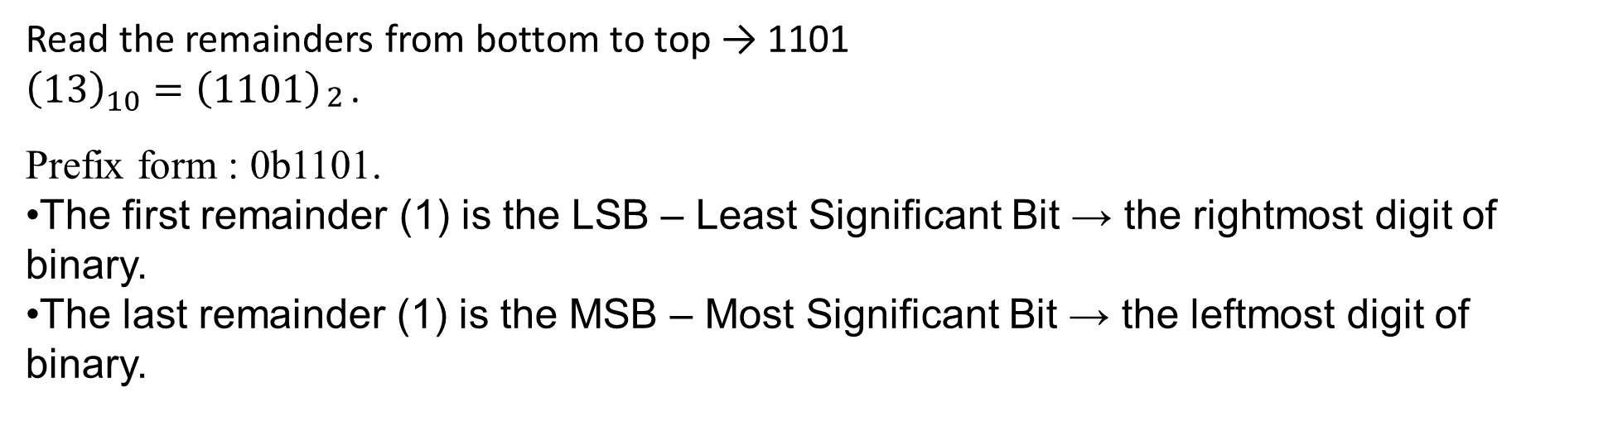

Use the division-remainder method to convert from decimal to binary
Example:
${\left(13\right)}_{10}$
Divide by | Quotient | Remainder
2 | 13 ÷ 2 = 6 | 1
2 | 6 ÷ 2 = 3 | 0
2 | 3 ÷ 2 = 1 | 1
2 | 1 ÷ 2 = 0 | 1
Read the remainders from bottom to top → 1101
${\left(13\right)}_{10}={\left(1101\right)}_{\begin{aligned}2 \\ \end{aligned}}$.
Prefix form : 0b1101.
The first remainder (1) is the LSB – Least Significant Bit → the rightmost digit of binary.
The last remainder (1) is the MSB – Most Significant Bit → the leftmost digit of binary.

Slide 14
Activity
Instructions:
Convert the following decimal numbers into binary
Identify least significant bit and most significant bit
(25)₁₀
(18)₁₀
(7)₁₀

Slide 15
Answers
1. (25)₁₀
Step 1: 25 ÷ 2 = 12 remainder 1 12 ÷ 2 = 6 remainder 0 6 ÷ 2 = 3 remainder 0 3 ÷ 2 = 1 remainder 1 1 ÷ 2 = 0 remainder 1
Step 2: → 11001
Answer: (25)₁₀ = (11001)₂ Prefix Form: 0b11001

Slide 16
2. (18)₁₀
Step 1: 18 ÷ 2 = 9 remainder 0 9 ÷ 2 = 4 remainder 1 4 ÷ 2 = 2 remainder 0 2 ÷ 2 = 1 remainder 0 1 ÷ 2 = 0 remainder 1
Step 2: → 10010 (18)₁₀ = (10010)₂ Prefix Form: 0b10010
3. (7)₁₀
Step 1: 7 ÷ 2 = 3 remainder 1 3 ÷ 2 = 1 remainder 1 1 ÷ 2 = 0 remainder 1
Step 2: → 111 (7)₁₀ = (111)₂ Prefix Form: 0b111

Slide 17
Conversion of Decimal
to Octal

Slide 18
To change a decimal number into octal, divide the number by 8 and write down the remainders.
step 1 | Divide the number by 8 and write the remainder
step 2 | Divide the quotient by 8 and write the remainder
step 3 | Repeat these steps until the quotient becomes 0
step 4 | Write the remainders from bottom to top order

Slide 19
Example(Division-remainder method)
Convert Decimal to Octal
(95)₁₀
Read Remainders from Bottom to Top
(95)₁₀ = (137)₈
The prefix form of the octal number is 0o137
Most Significant Digit (MSD): 1 (leftmost)
Least Significant Digit(LSD): 7 (rightmost)
Divide by | Quotient | Remainder
8 | 95÷ 8=11 | 7
8 | 11 ÷ 8=1 | 3
8 | 1 ÷ 8=0 | 1

Slide 20

Activity
Instruction:
Convert decimal to Octal
Identify least significant digit and most significant digit
${14}_{10}$
${33}_{10}$
${50}_{10}$
$7_{10}$

Slide 21
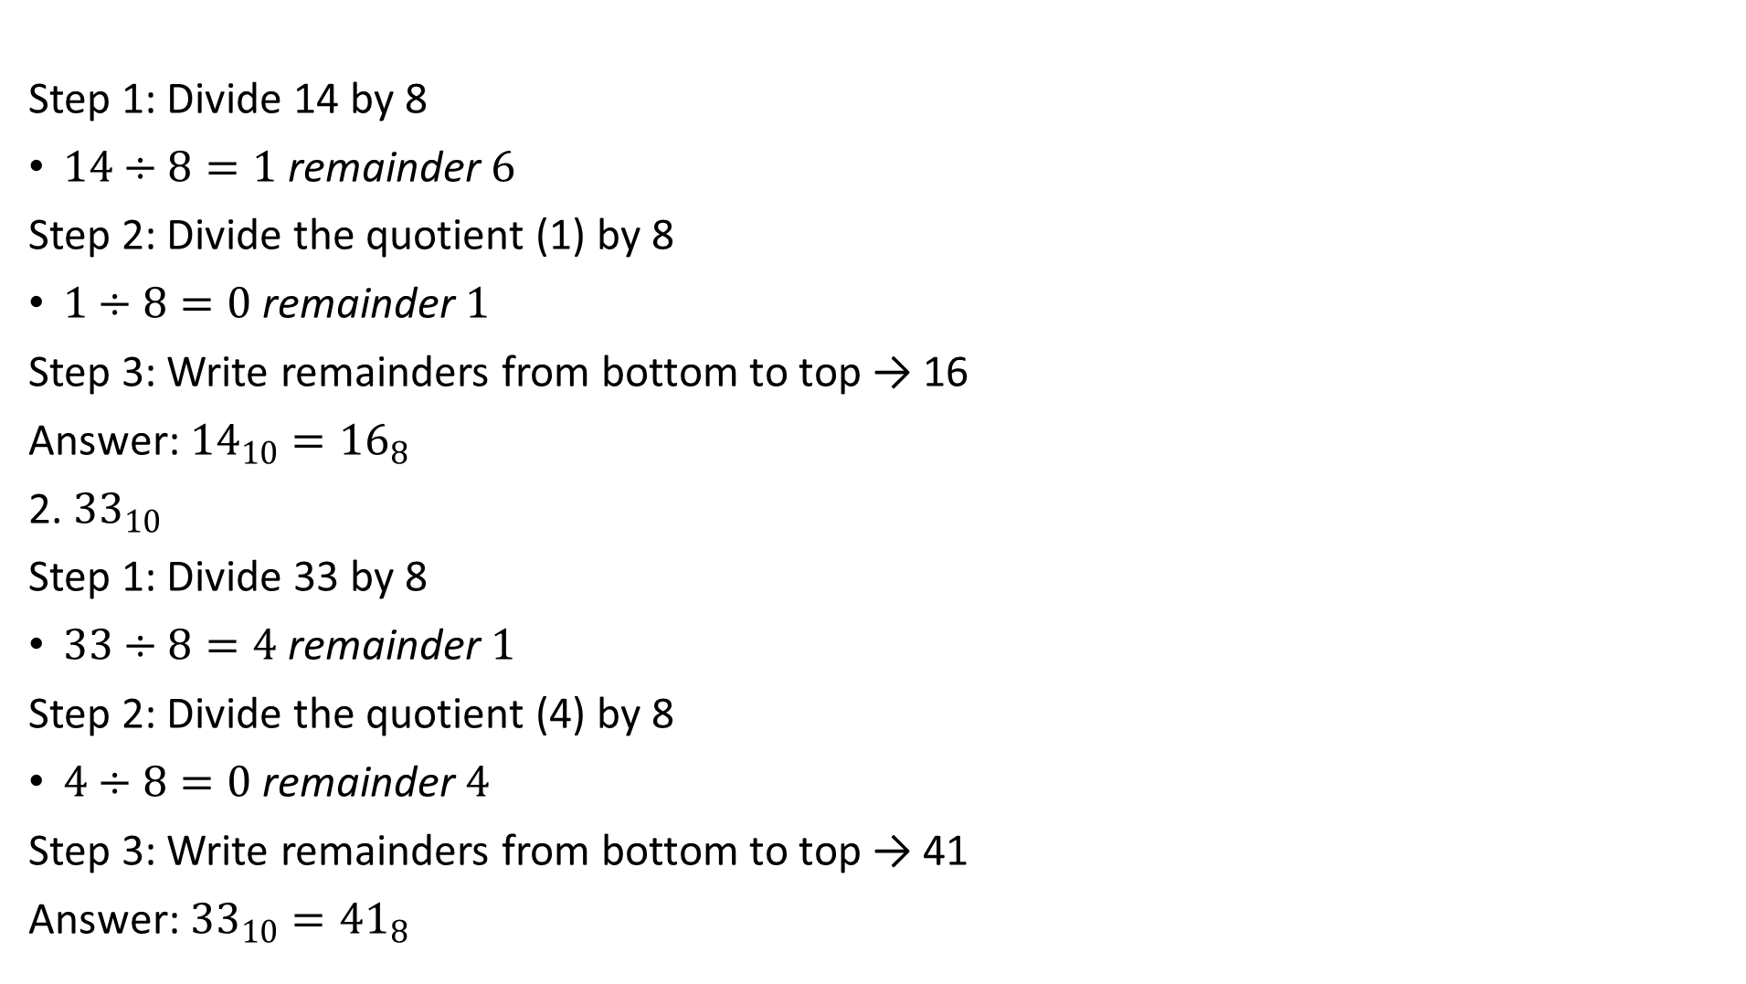
Answer
Step 1: Divide 14 by 8
$14÷8=1 \text{remainder} 6$
Step 2: Divide the quotient (1) by 8
$1÷8=0 \text{remainder} 1$
Step 3: Write remainders from bottom to top → 16
Answer: ${14}_{10}={16}_{8}$
2. ${33}_{10}$
Step 1: Divide 33 by 8
$33÷8=4 \text{remainder} 1$
Step 2: Divide the quotient (4) by 8
$4÷8=0 \text{remainder} 4$
Step 3: Write remainders from bottom to top → 41
Answer: ${33}_{10}={41}_{8}$

Slide 22
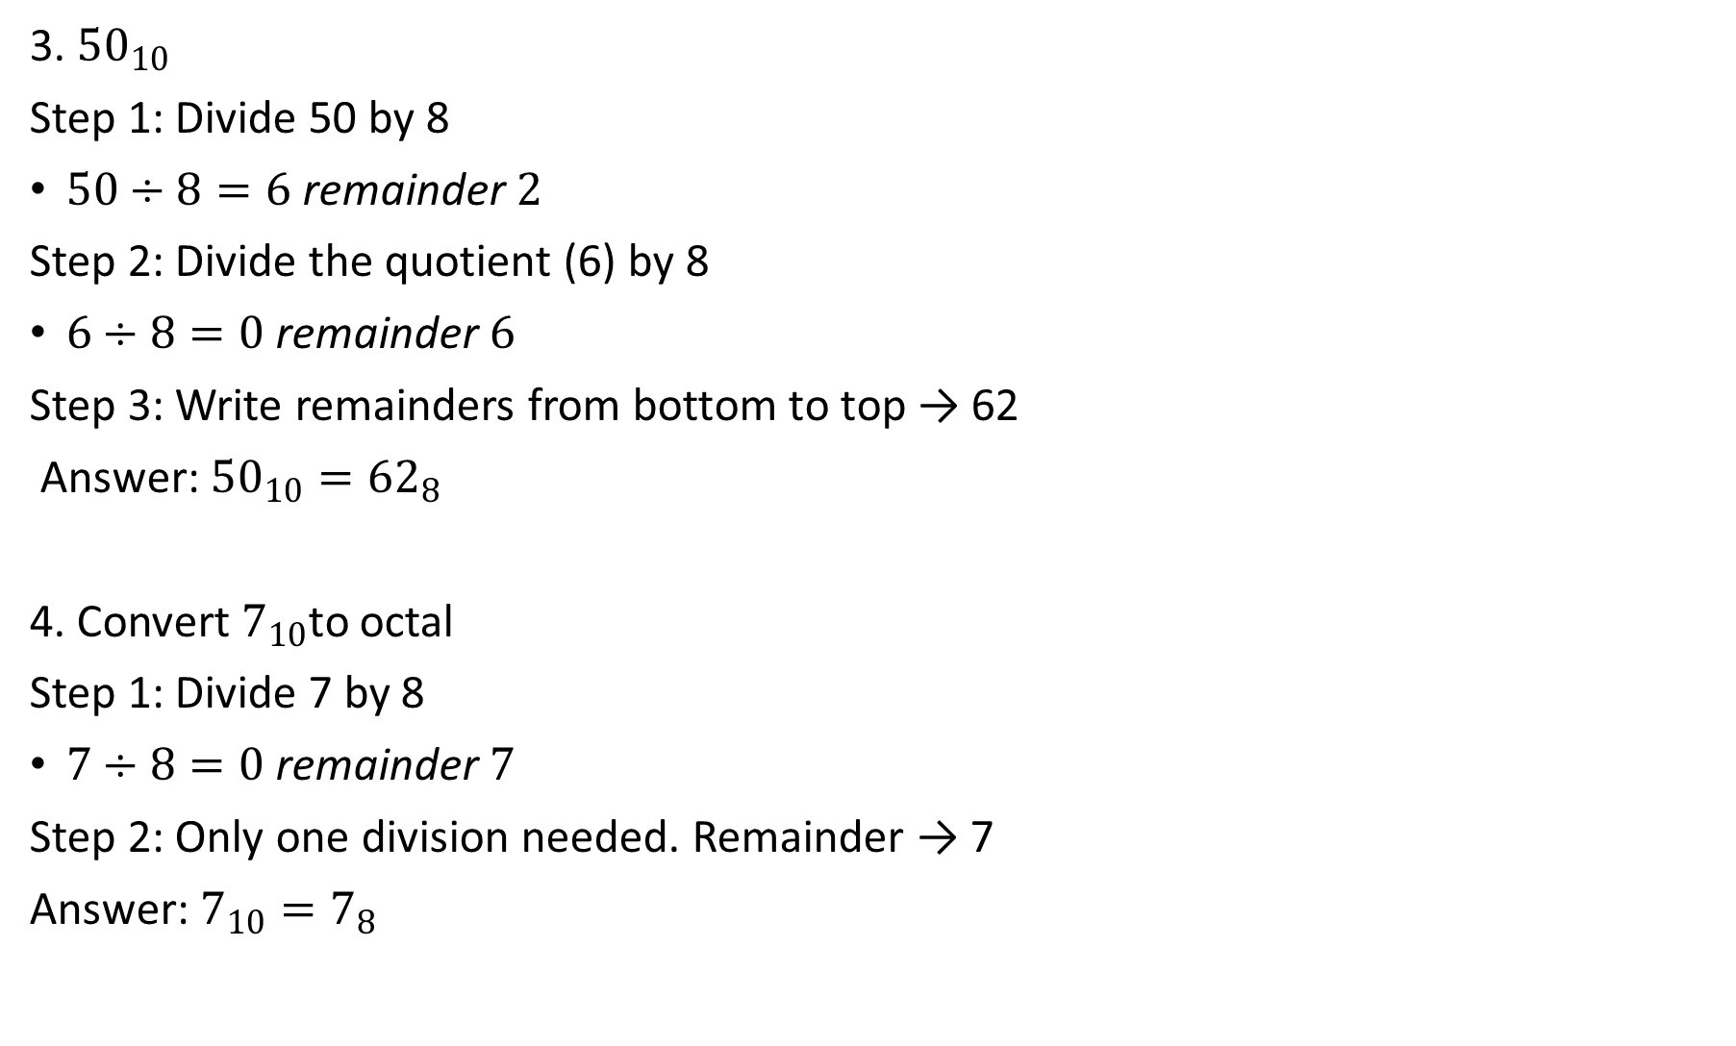
3. ${50}_{10}$
Step 1: Divide 50 by 8
$50÷8=6 \text{remainder} 2$
Step 2: Divide the quotient (6) by 8
$6÷8=0 \text{remainder} 6$
Step 3: Write remainders from bottom to top → 62
Answer: ${50}_{10}={62}_{8}$
4. Convert $7_{10}$to octal
Step 1: Divide 7 by 8
$7÷8=0 \text{remainder} 7$
Step 2: Only one division needed. Remainder → 7
Answer: $7_{10}=7_{8}$

Slide 23
Conversion of Decimal to Hexadecimal

Slide 24
To change a decimal number into hexadecimal, divide the number by 16 and write down the remainders.
step 1 | Divide the number by 16 and write the remainder
step 2 | Divide the quotient by 16 and write the remainder
step 3 | Repeat these steps until the quotient becomes 0
step 4 | Write the remainders from bottom to top order

Slide 25
Example(Division-remainder method)
254₁₀
In hexadecimal:
10 → A
11 → B
12 → C
13 → D
14 → E
15 → F
Remainders from bottom to top: 15 → F, 14 → E
254₁₀ = FE₁₆
The prefix form of the hexadecimal number is 0xFE.
Divide by | Quotient | Remainder
16 | 254 ÷ 16=15 | 14
16 | 15 ÷ 16=0 | 15

Slide 26

Activity
Instructions:
Convert Decimal to Hexadecimal
${26}_{10}$
${59}_{10}$
${124}_{10}$

Slide 27
Answer
26₁₀
Step 1:
26 ÷ 16 = 1 remainder 10
Step 2: 1 ÷ 16 = 0 remainder 1
10 = A in Hex
Read from bottom to top: 1A
26₁₀ = 1A₁₆
Prefix form: Ox1A

Slide 28

2. 59₁₀
Step 1:
59 ÷ 16 = 3 remainder 11
Step 2:
3 ÷ 16 = 0 remainder 3
11 = B in Hex
Read from bottom to top: 3B
59₁₀= 3B₁₆. Prefix form:0x3B
3. ${124}_{10}$
Step 1:
124 ÷ 16 = 7 remainder 12
Step 2:
7 ÷ 16 = 0 remainder 7
12 = C in Hex
Read from bottom to top: 7C
${124}_{10}=$7C₁₆. Prefix form: 0x7C

Slide 29
THANK YOU

